Slide 1
Machine Learning Use Cases
04/03/2019
CONFIDENTIAL AND PROPRIETARY
This material constitutes confidential and proprietary information of Sterling Talent Solutions and its reproduction, publication or disclosure to others without the express authorization of the CEO or General Counsel of Sterling is strictly prohibited. This presentation and related materials is for informational purposes and represents the expectation of Sterling today only. It is subject to change at any time, for any reason, without notice and Sterling undertakes no duty to provide any update or change at any time. The information presented is not a promise or contract of any kind. Nothing contained herein is legal advice. Sterling recommends working with your legal counsel to ensure overall screening program compliance. Sterling is a service mark of Sterling Infosystems.

Slide 2

Proposed Projects
Initial ETA Prediction (In Detail)
Hit and Clear Classification
Extracting case and charge details from free text.(text mining)

Slide 3
Initial ETA

Slide 4
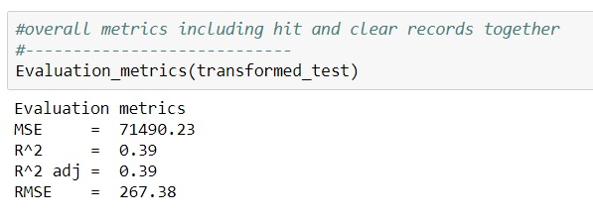
Requirements
Predict ETA of a verification request as soon as it is created.
Target accuracy of 80%, which is 41% More than AWS Sagemaker prediction.

Slide 5
Technical Stack
Machine Learning in Python
Reporting in Python
Data in CSV format

Slide 6
Scope
To replace manual prediction with automation.
To increase prediction accuracy by using live and historical data.
Data sources:
Prism Data (latest and historical data)
AG Data (latest and historical data)

Slide 7
Sonata ETA Model Prediction Details
Environment: AWS Sagemaker
Data sources: Collective data from AG, Prism, Client and Admin databases.
Observations: Data consists of all hit/clear, automate/manual requests.
Input Features: ‘Name’, ‘State’, ‘County’, ‘Vendor Name’, ‘Start Date’, ‘End Date’, ‘Product ID’
Feature Engineering: New features created ex: Names → common names,
start date → Week of day. etc
Model: XG-Boost Algorithm used for prediction, got accuracy of 37%.
Outcome: Single request prediction and batch prediction.

Slide 8
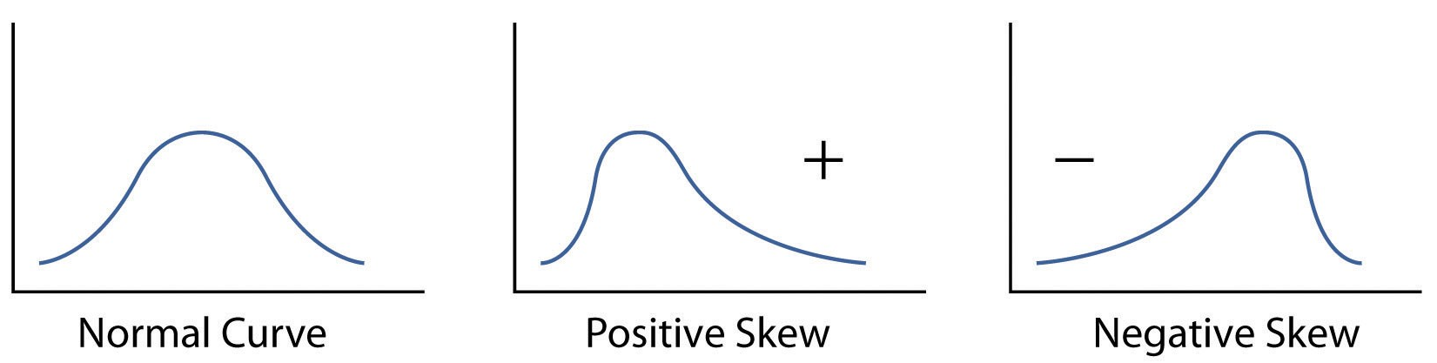
Modified Design
Environment: Jupyter ID, Anaconda
Datasources: Data from Prism and AG database separately
Observations: Split data into Hit and Clear status and analyze each outcome separately.
Group Analysis: Group each State-County requests.
Feature Engineering: Separate data into normal, positive and negative skew data
Zero Skew: mean ETA
Left Skew: mean ETA, after handling lower outliers
Positive Skew: mean ETA, after handling upper outliers
Outcome: Aggregating the ETA for each State-county.

Slide 9
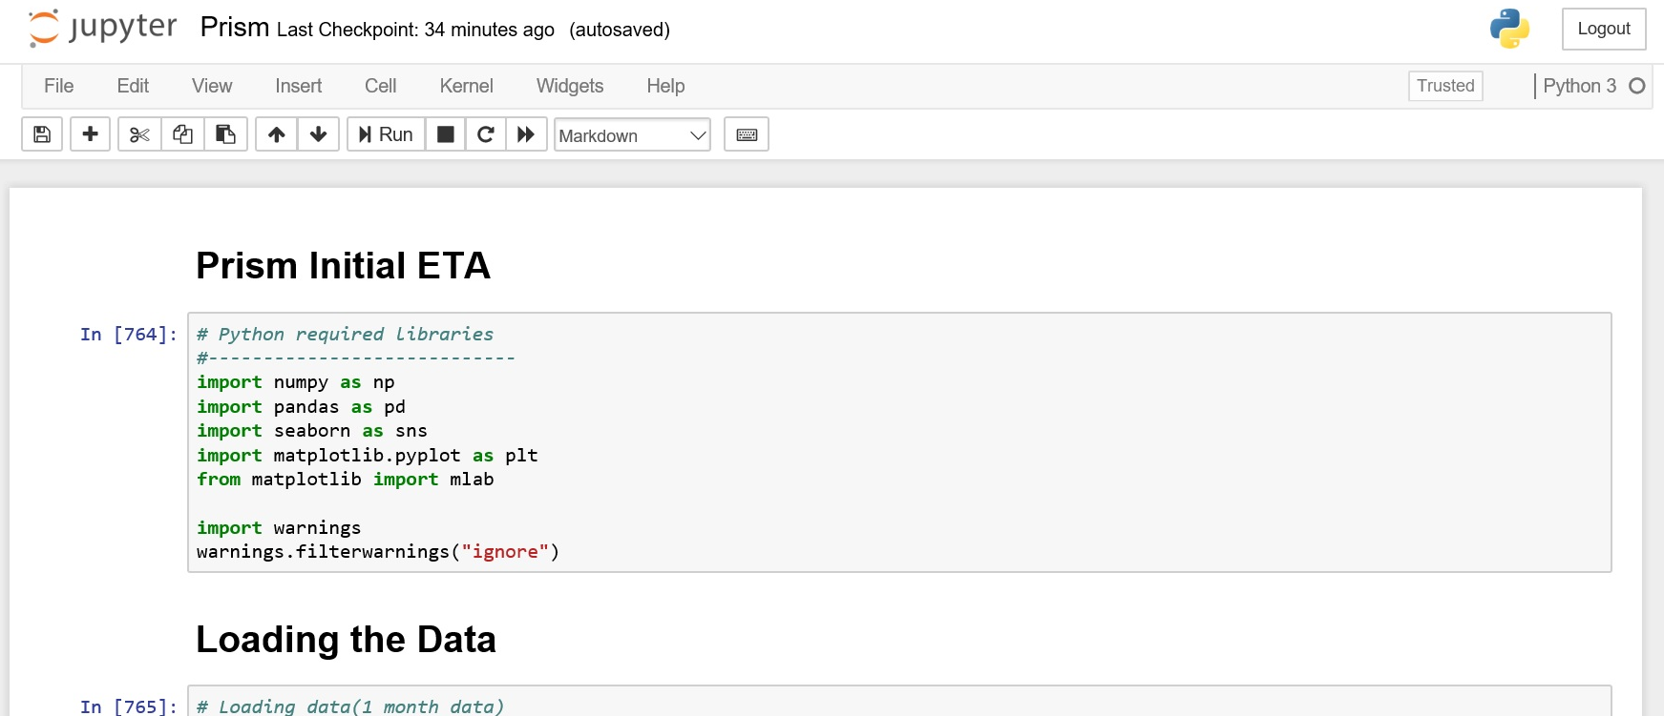
Python Code Execution

Slide 10

Time Estimation
Start Date: 04-01-2019
Requirements/ Meetings with concerned departments .
1st Week
Define
Data Collection
From Prism (Automation)
From AG (Manual)
2nd Week
Loading the data
Cleaning/verifying the data.
Classifying each State-county Data
Analyzing the data
Combining all the calculated ETA for each county into a single file.
Same steps will be involved for Hit Data.
Development
5th Week
End Date: 06-10-2019
Application API Integration
Communicating through Flask
6th Week
UAT Deployment and Testing
Deployment to UAT server
UAT testing
7th Week
Live Deployment and Testing
Deployment to Live server.
Live Testing
9th Week
Evaluate
Validating Predicted ETA with latest request TAT.
10th Week

Slide 11
Hit and Clear Classification

Slide 12
Requirements and Benefits
Predict new request into Hit or Clear classification, as soon as the order is created.
To get more precise ETA for completion of new request.

Slide 13
Extracting case and charge details (text mining)

Slide 14
Requirements and Benefits
Build a learning NLP model.
To separate out each case/charge from free text.
Validate each separated charge.
Reduce manual efforts and TAT.

Slide 15
Thanks

